Slide 1
Fundamental Information of this Course
Electromagnetics (电磁学)
Students: Majoring in EE
Feb. 14, 2017 ~ May 30, 2017 (16 weeks)
Classroom: SIST Bldg. Rm. 1D108
Lecture: Tuesday & Friday (odd weeks) 10:15 ~ 11:55
Lab session: SIST Bldg. Rm. 1D102 Small Class 1: Thursday 13:00 ~ 15:45 Small Class 2: Friday 15:00 ~ 17:35 Detailed schedule will be determined later
Discussions and Exercises: TBD Quiz: every week in discussion class
Additional lecture: Discussion class in dual weeks
Blackboard system: TBD

Slide 2
Information of Instructor and TA
Xiong Wang (王雄), Assistant Professor
Office: SIST Bldg., Rm. 1D301B
Office hour: Tuesday 13:00~15:00
Telephone: 20685264
Email: wangxiong@shanghaitech.edu.cn
TA (grader): 高鸿翔 gaohx@shanghaitech.edu.cn 李芸婷 lity2@shanghaitech.edu.cn
TA (lab): 张一弛 zhangych@shanghaitech.edu.cn 王保胜 wangbsh@shanghaitech.edu.cn
Lab teacher: 李娟 lijuan@shanghaitech.edu.cn

Slide 3
Policies
Attitude: work hard during the entire semester
Integrity: homework, experiments, class projects, quiz, exams (will be included in the final grade)
Attendance: Lecture: required, about 10 random roll call in 28 lecture days (will be included in the final grade) Lab: required, 0 point for one lab session if absent. Reschedule is possible, but needs to get my permission in advance Quiz: required. Make-up is possible, but get a 30% deduction in the points and no more than two times during this semester Exam: required, 0 point for one exam if absent and no make-up exam
Classroom discipline: DO NOT allow playing games and watching videos on smart phones, tablets or laptops

Slide 4
Policies (cont.)
Bonus points: 0.5,1 or 1.5 points per time is awarded to students who can answer some of my questions and ask me in-depth questions (will be included in the final grade)
Homework: assigned every week and collected next week in class. If you cannot finish it on time, you can turn in on the next class day but with a 20% deduction of the points. No homework is accepted after that. Everyone should try to work on homework problems independently. Discussion between students and searching online is allowed, but you must finally work on it by yourself even if you get some help elsewhere. Copying from each other, copying solutions, or copying the old-version homework of the junior students will be strictly punished

Slide 5
Policies (cont.)
Exams: closed-book and closed-notes, can take some pages (one for each midterm and 3 for final) of A4 size cheat sheet with equations, notes, figures or whatever you want to write on both sides of the papers. You need to get a calculator able to do calculations of complex numbers, exponential operation, trigonometric function and so on. Any kind of cheating in an exam will receive 0 point for that exam and extra penalty in the final grade
Lab session: students are grouped into teams of 2 for each lab session. Each team work together to finish all the required steps for an experiment and write a lab report together. Some reading is needed for some lab sessions before doing the experiments

Slide 6
Policies (cont.)
The students who rank in the top two based on their overall performance during the whole semester just before the final exam will be exempt from the final exam. This bonus aims to offer you more time in preparing exams of other courses

Slide 7
Project for EE Major (2 Extra Credits)
Hopefully will start around the 14th week and is extended to the Summer Semester
Different topics to choose. Students are encouraged and welcome to discuss possible topics designed by themselves
Students are grouped into teams of 2 or 3 and each team work on the selected topic together
Each project topic involves literature study, theoretical design, simulation using software, coding, fabrication, measurement, and report writing
Some topics can be further explored to gain you more experience in research and publishing a paper is also possible

Slide 8
Major Purposes of This Course
Expose you with fundamental knowledge, phenomenon, and applications of electromagnetics

Slide 9
Teaching Style
Not only knowing the hows but also the whys
Intuitive interpretation and practical examples of some elusive concepts, theorems, formulas, and phenomena. In another word, using physics to explain mathematics and taking advantage of some intuitive examples to unravel physics
Try to make you understand the most basic and important concepts in class

Slide 10
My Wechat Account
wangxiong_shtech

Slide 11
Syllabus
See your handouts

Slide 12
Chapter 1 Overview
Electrostatics (does not change with time)
Magnetostatics (does not change with time)
Electromagnetics (vary with time, i.e. time-varying)
Electrostatics
DC
Decoupled
Fields
Force
Magnetostatics
Electromagnetics
AC
Coupled
Waves
Energy

Slide 13
Examples of EM Applications

Slide 14
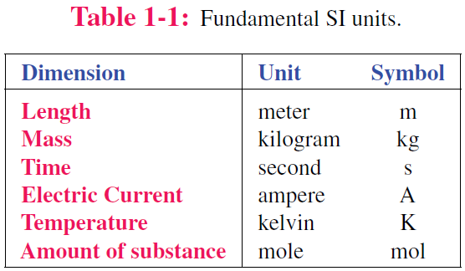
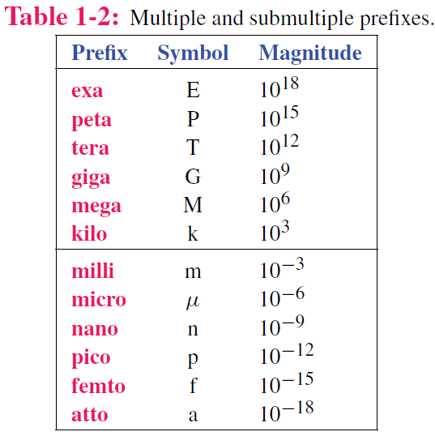
Dimensions and Units
Luminous intensity candela cd

Slide 15
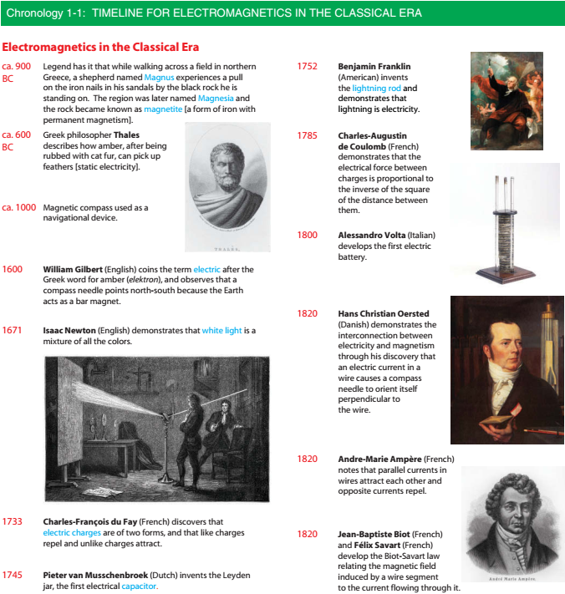

Slide 17
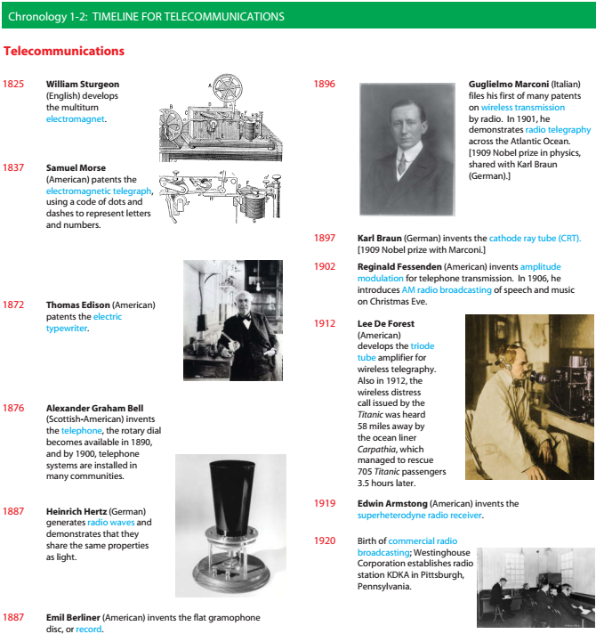

Slide 19
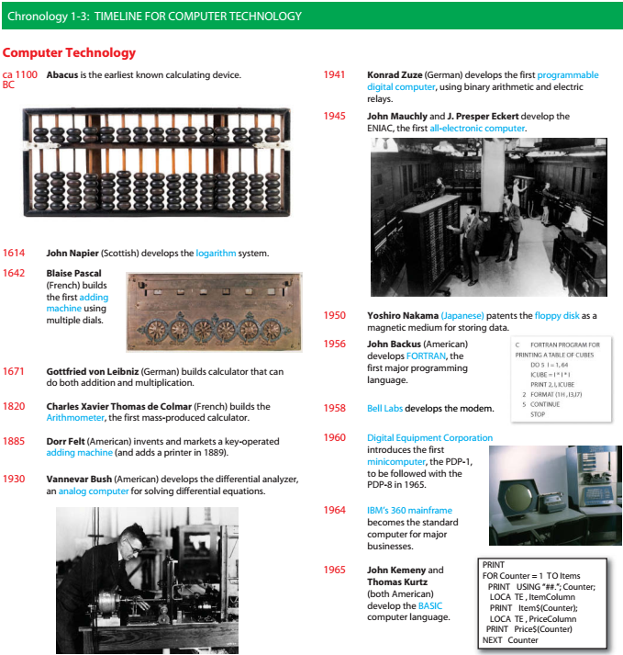

Slide 21
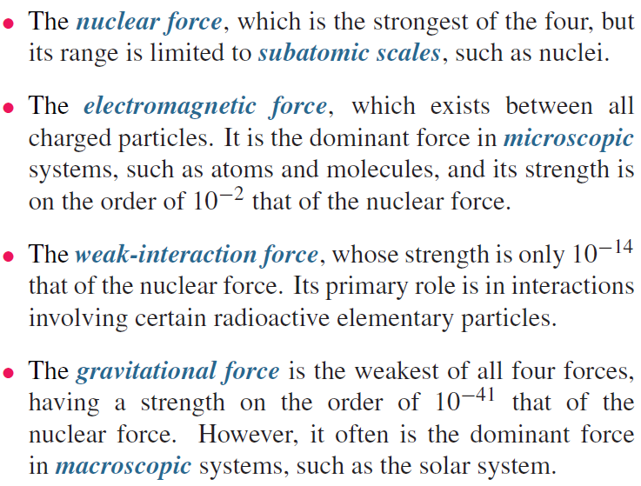
Fundamental Forces of Nature

Slide 22
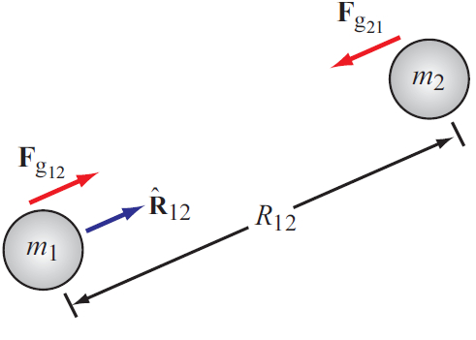
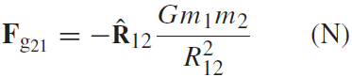
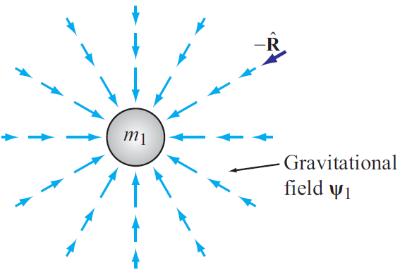
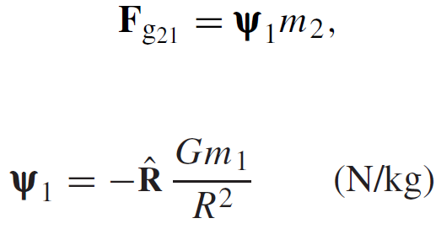
Gravitational Force
Force exerted on mass 2 by mass 1
Action at a distance
Gravitational FIELD induced by mass 1

Slide 23
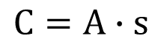
Charge: Electrical property of particles
Units: coulomb
$$C=A∙s$$
One coulomb: amount of charge accumulated in one second by a current of one ampere.
1 coulomb represents the charge on ~ 6.241 x 10¹⁸ electrons
The coulomb is named for a French physicist, Charles-Augustin de Coulomb (1736-1806), who was the first to measure accurately the forces exerted between electric charges.
Charge of an electron
e = 1.602 x 10⁻¹⁹ C
Charge conservation
Cannot create or destroy charge, only transfer

Slide 24
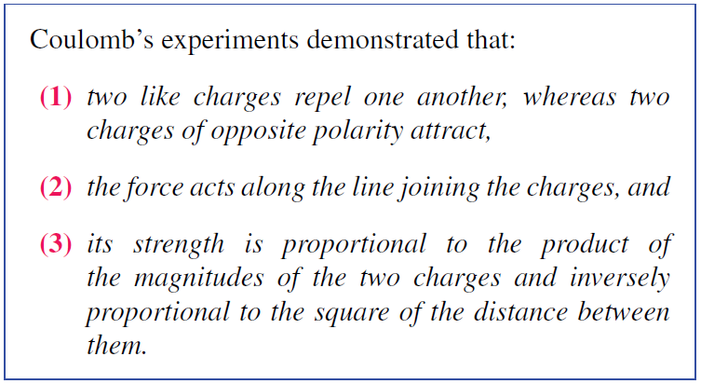
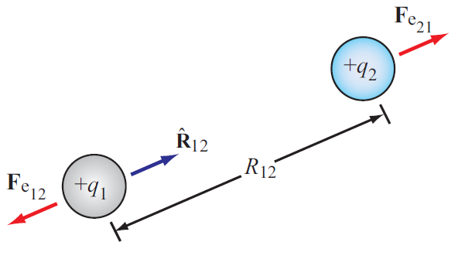
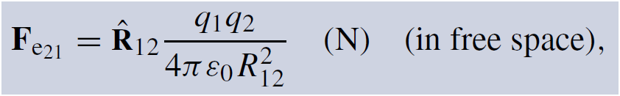
Electrical Force
Force exerted on charge 2 by charge 1
ε₀ = 8.854 × 10⁻¹² farad per meter (F/m)
Permittivity of free space

Slide 25
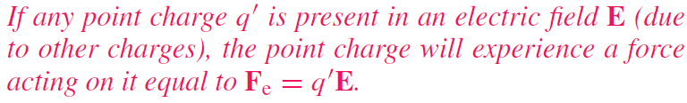
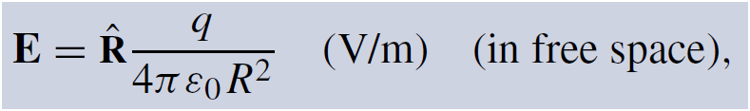
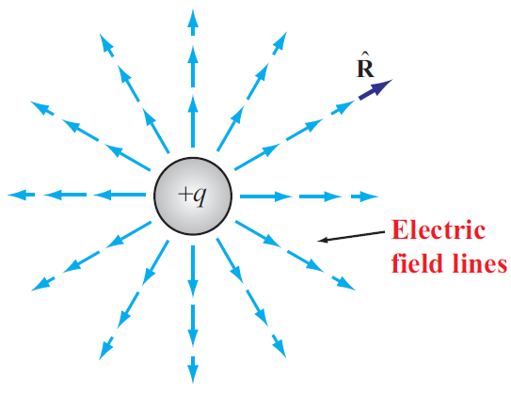
Electric Field In Free Space
Permittivity of free space

Slide 26
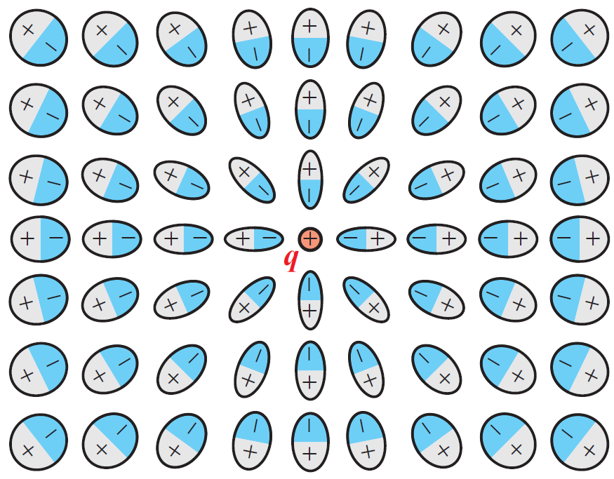
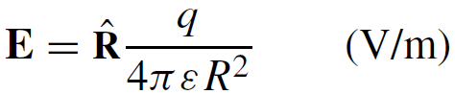
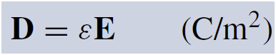
Electric Field Inside Dielectric Medium
Polarization of atoms changes electric field
New field can be accounted for by changing the permittivity
Permittivity of the material
Another quantity used in EM is the electric flux density D:
Electric dipole

Slide 27
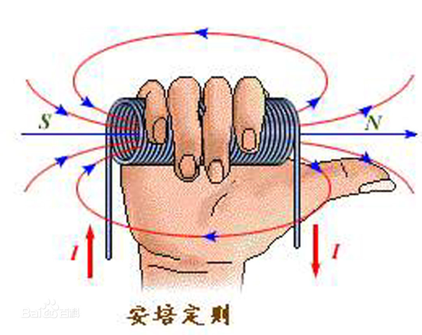
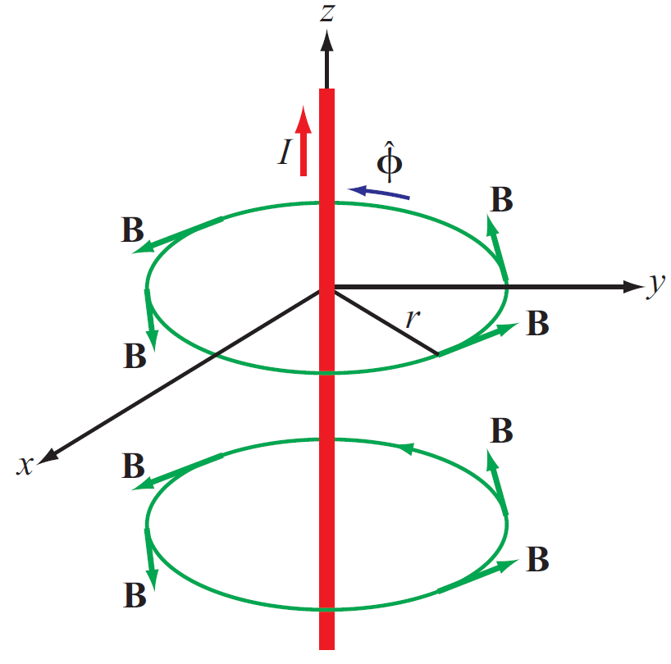
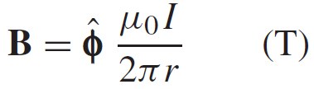
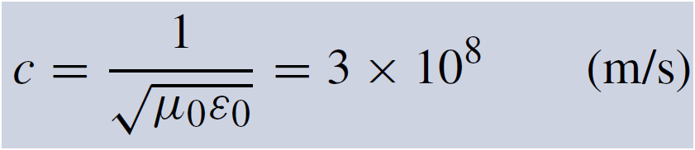
Magnetic Field
Electric charges can be isolated, but magnetic poles always exist in pairs.
Magnetic field induced by a current in a long wire
Magnetic permeability of free space
Electric and magnetic fields are connected through the speed of light:

Slide 28
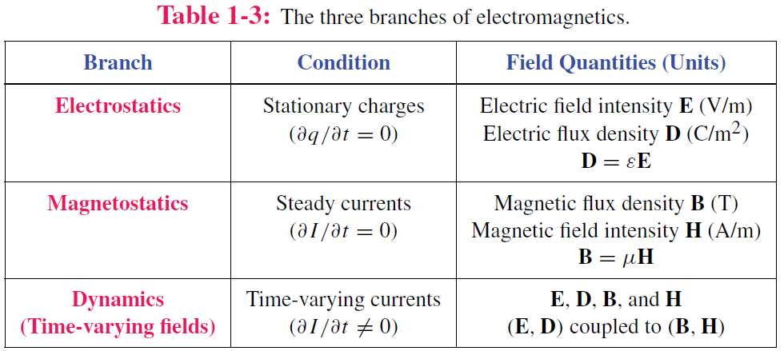
Static vs. Dynamic
Static conditions: charges are stationary or moving, but if moving, they do so at a constant velocity.
Under static conditions, electric and magnetic fields are independent, but under dynamic conditions, they become coupled.

Slide 29
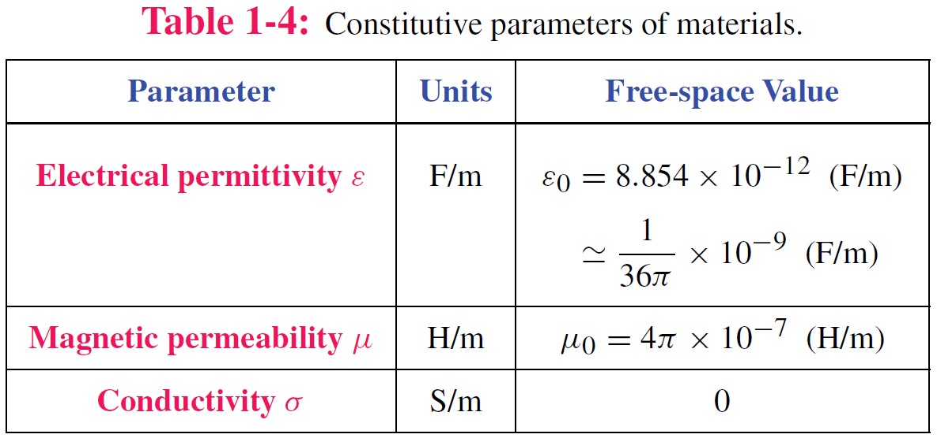
Material Properties

Slide 30
Traveling Waves
Waves carry energy
Waves have velocity
Many waves are linear: they do not affect the passage of other waves; they can pass right through them
Transient waves: caused by sudden disturbance
Continuous periodic waves: repetitive source

Slide 31
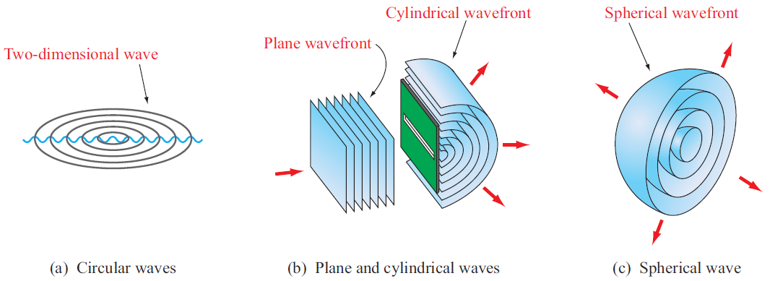
Types of Waves

Slide 32
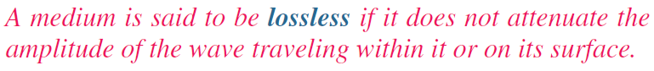
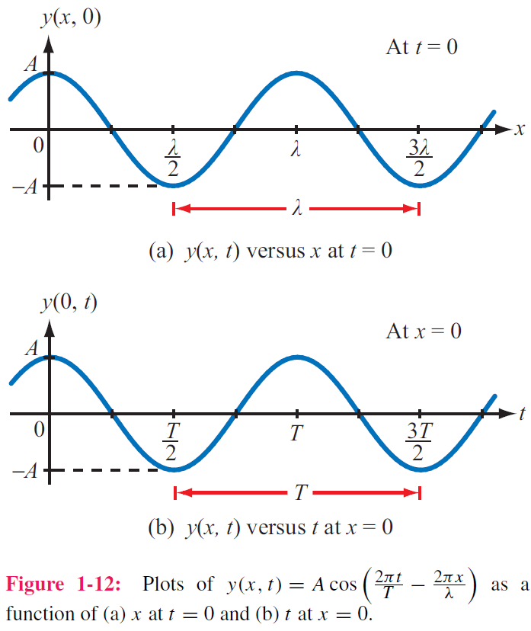
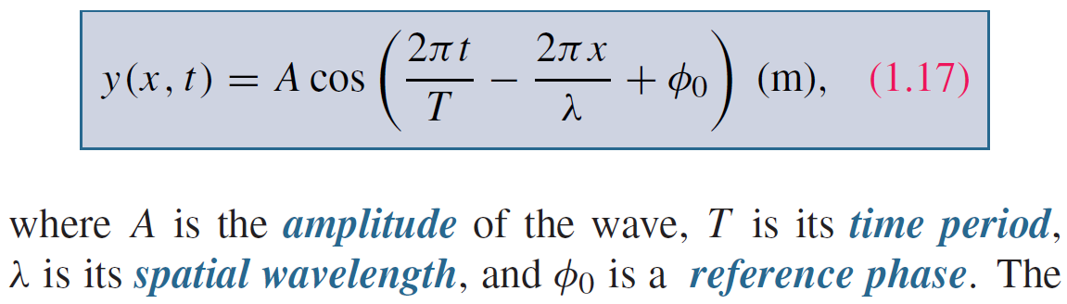
Sinusoidal Waves in Lossless Media
Take wave on water as an example
y = height of water surface
x = distance

Slide 33
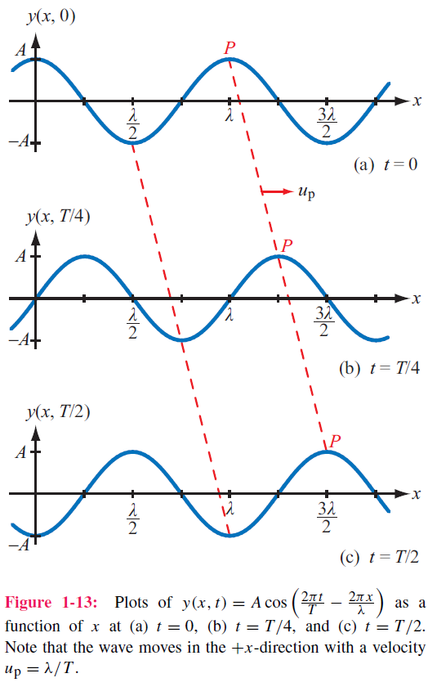
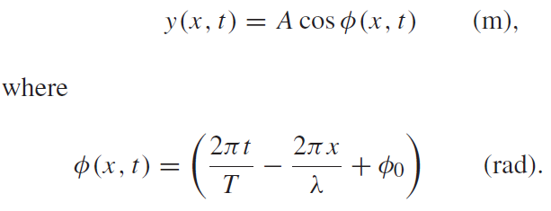
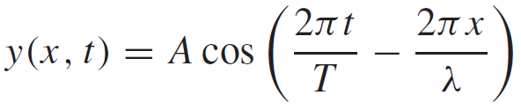
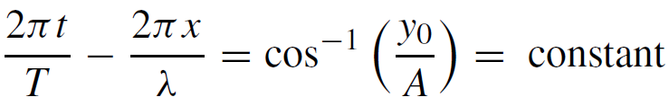
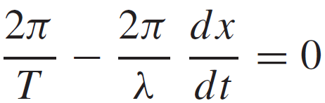
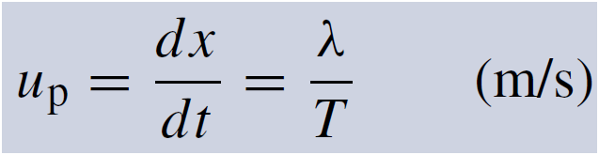
Phase velocity
If we select a fixed height y₀ and follow its progress, then
=

Slide 34
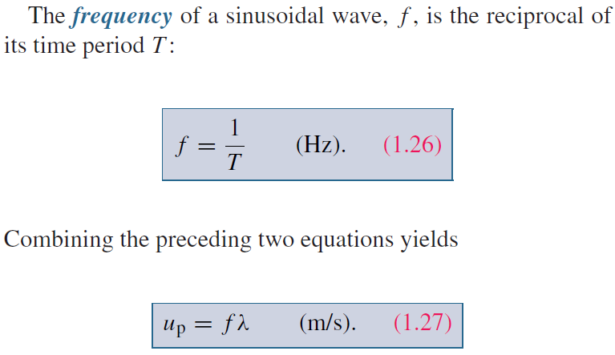
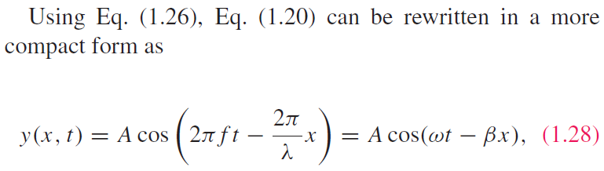
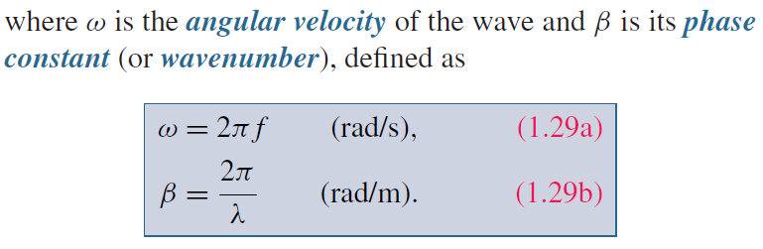
Wave Frequency and Period

Slide 35
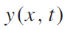
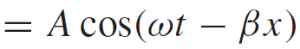
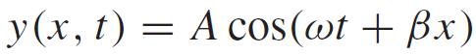
Direction of Wave Travel
Wave travelling in +x direction
Wave travelling in ‒x direction
+x direction: if coefficients of t and x have opposite signs
‒x direction: if coefficients of t and x have same sign (both positive or both negative)

Slide 36
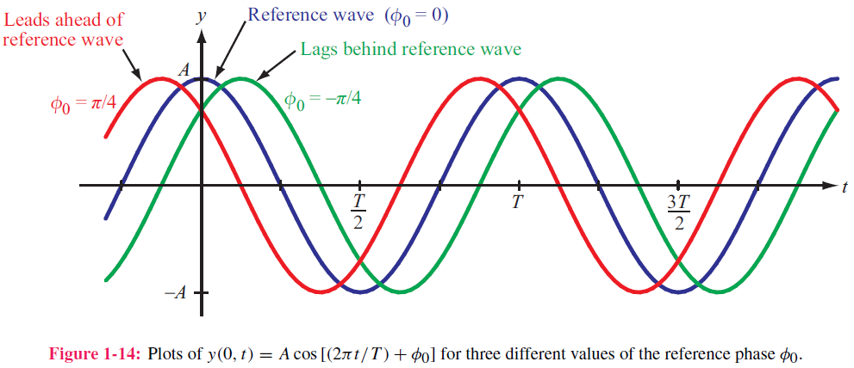
Phase Lead & Lag

Slide 37
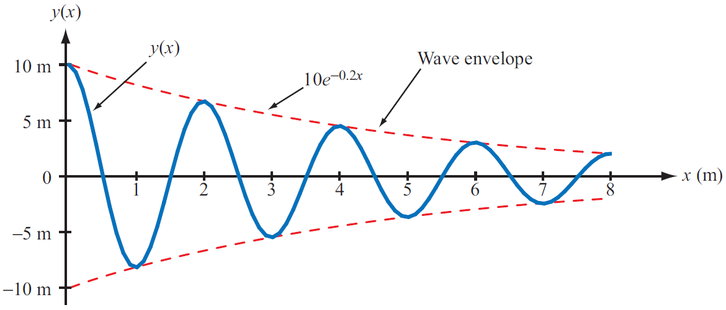
Wave Travel in Lossy Media
Frequency does not change
Attenuation factor

Slide 38
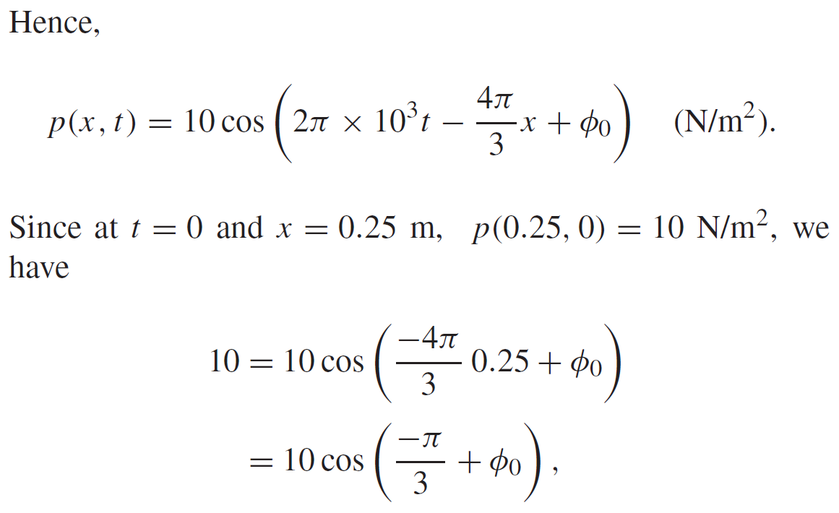
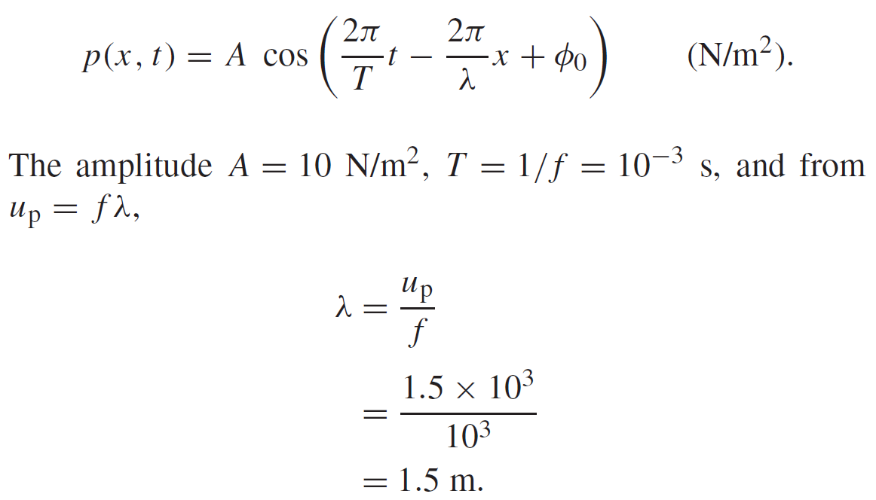
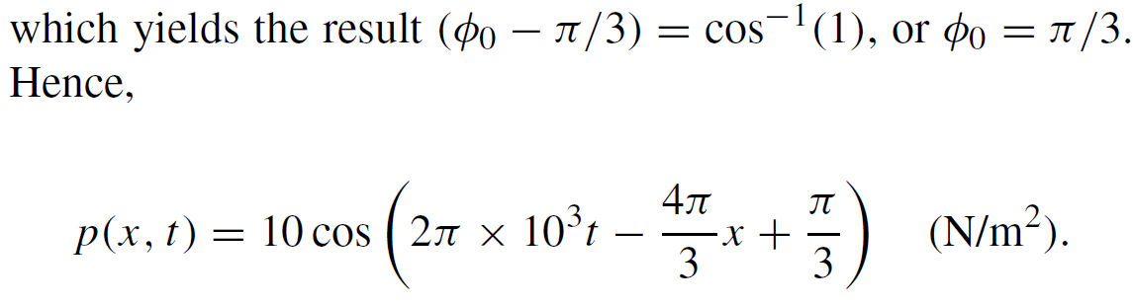
Example 1-1: Sound Wave in Water
Given: sinusoidal sound wave traveling in
the positive x-direction in water
Wave amplitude is 10 N/m2, and p(x, t) was observed to be at its maximum value at t = 0 and x = 0.25 m. Also f=1 kHz, up=1.5 km/s.
Determine: p(x,t)
Solution:

Slide 39
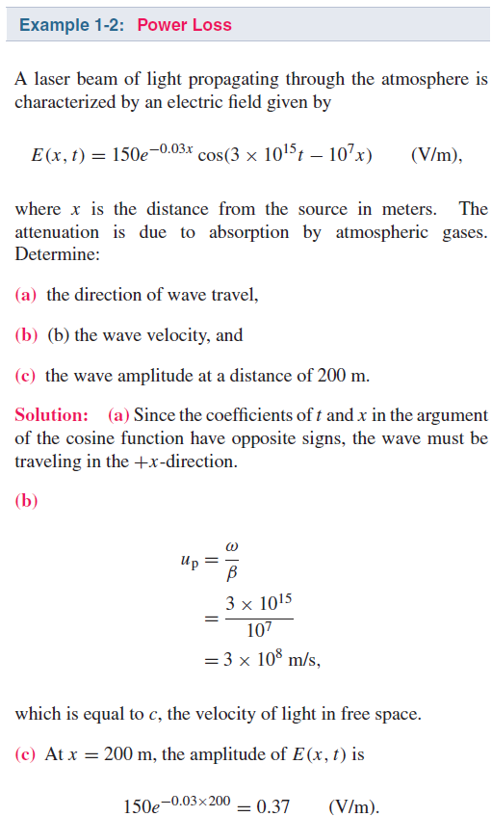

Slide 40
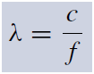
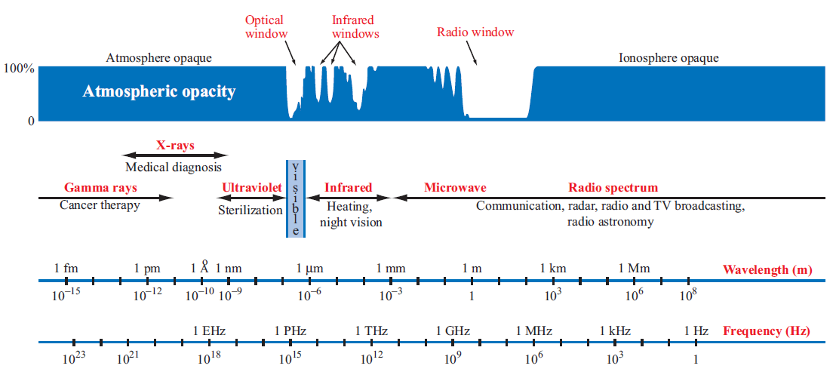
The EM Spectrum

Slide 41


Slide 42

Complex Numbers
We will find it is useful to represent sinusoids as complex numbers
Rectangular coordinates
Polar coordinates
Relations based on Euler’s Identity

Slide 43

Relations for Complex Numbers
Learn how to perform these with your calculator/computer

Slide 44

Phasor Domain
1. The phasor-analysis technique transforms equations
from the time domain to the phasor domain.
2. Integro-differential equations get converted into
linear equations with no sinusoidal functions.
3. After solving for the desired variable--such as a particular voltage or current-- in the phasor domain, conversion back to the time domain
provides the same solution that would have been obtained had the original integro-differential equations been solved entirely in the time domain.

Slide 45





Phasor Domain
Phasor counterpart of

Slide 46

Time and Phasor Domain
It is much easier to deal with exponentials in the phasor domain than sinusoidal relations in the time domain
Just need to track magnitude/phase, knowing that everything is at frequency ω

Slide 47

Phasor Relation for Resistors
Current through resistor
Time domain
Time Domain
Frequency Domain
Phasor Domain

Slide 48


Phasor Relation for Inductors
Time domain
Phasor Domain
Time Domain

Slide 49


Phasor Relation for Capacitors
Time domain
Time Domain
Phasor Domain

Slide 50
Example

Slide 51







ac Phasor Analysis: General Procedure

Slide 52
Example 1-4: RL Circuit
Cont.

Slide 53
Example 1-4: RL Circuit cont.

Slide 54


Slide 55

Summary

